Slide 1
When Focus Matters: Designing for Changes in Content versus Context
CSUN Assistive Technology Conference 2018 - March 22, 2018
Slides & Demos: https://www.tinyurl.com/csunatc18-cgi

Slide 2
A Little Bit About Us…
CGI: 5th largest independent IT and business process services firm in the world
72,500 professionals worldwide
400 locations in 40 countries
Committed to helping our clients succeed.
95% on-time, within-budget delivery
9 out of 10 clients would recommend us for further work
Human Factors Practice (HFP) within CGI Federal
team of subject matter experts (SMEs) with deep knowledge of Section 508 and digital accessibility
internal consultants who independently advise and assess the accessibility of our teams’ solutions
We are passionate about accessibility and dedicated to universally improving access to government systems and information.
Notes:
About CGI Federal
Founded in 1976, CGI is the fifth largest independent IT and business consulting services firm in the world. With approximately 72,500 professionals worldwide, CGI delivers an end-to-end portfolio of high-end IT and business consulting services, systems integration and IT and business process outsourcing services. CGI's client proximity model, best-fit global delivery network, and intellectual property solutions help clients accelerate results and digitally transform their organizations. With annual revenue of C$10.8 billion, CGI shares are listed on the TSX (GIB.A) and the NYSE (GIB). Website: cgi.com.

Slide 3
Session Abstract & Objectives
Abstract: CGI will explore the distinction between “changes in content” versus “changes in context” and share lessons learned on designing focus management for dynamic interaction patterns.
In today’s session, we want to:
Answer the question: “When do I need to manage focus?”
Define “changes in content” versus “changes in context”
Review WCAG 2.0 success criteria related to focus management
Share a “change of content” lesson learned related to drop-down lists
Share some interaction design best practices
Take a peek at the future, the WCAG 2.1 requirements
Slides are available for download: tinyurl.com/csunatc18-cgi

Slide 4
If a new developer has never tried to use anything but a mouse and has never used a screen reader it's really hard to explain how keyboard focus might need to work… ~ Developer
Notes:
Insightful…most developers are familiar/comfortable with using a mouse or touch pad to navigation and operate a UI in a random access model…Keyboard and Screen Reader access methods require a fundamental shift in mental models to a sequential access model

Slide 5
“When do I need to manage focus?”

Slide 6
Art, Not Science: Crafting the UI “Conversation”
Generally speaking users don’t expect a system to “steal” their focus (aka their context) and move it without their permission.
At the same time, users do
Expect the interface to “respond” to their actions and input
Desire an efficient experience
It’s our responsibility to question if the UI “conversation” we are creating is understandable….
What is your user’s goal?
What is your user expecting to happen based on their input method ?
Is the system’s response predictable given the user’s action or the UI element they interacted with?
Is the system’s response disruptive to the user’s goal/task?
Notes:
Define User Input / System Output Design Patterns
User Input = User starts the “conversation”
System Output = Can be done through messaging, content changes and/or context changes
Every year we encounter new web designs and have to evaluate if the designers’ new “responsive” patterns for interaction design are inclusive
To do this we leverage our knowledge of the technical standards (WCAG 2.0, WAI-ARIA 1.1) but we also have to remember that to be truly inclusive these new interaction designs must be functionally usable by a diverse set of users with different preferences and input methods.

Slide 7
What’s the Difference? Content Changes Versus Context Changes
A change of content is NOT always a change of context
When developers use scripting to change a user’s focus this is a type of “Change of Context”
Changes of context are major changes in the content of the Web page that, if made without user awareness, can disorient users who are not able to view the entire page simultaneously Source: WCAG 2.0 Glossary (Normative): https://www.w3.org/TR/WCAG20/#glossary
However, there are types of dynamic content changes that do NOT need to change the user’s context…
“Traditional” HTML navigation menu
WAI-ARIA Tooltip widget
WAI-ARIA Accordion or Show/Hide widget
WAI-ARIA Tabs
Notes:
As a first step, let’s define what a change of context is versus what a change of content is…
For today’s session we are predominantly going to focus on discussing changes of content that should and should NOT trigger a change of content, specifically a change of focus.

Slide 8
Relevant WCAG 2.0 Success Criteria (SC)
What to DO for Focus is in…
Principle 2 Operable
Guideline 2.1 Keyboard Accessible
SC 2.1.1 Keyboard (Level A)
Guideline 2.4 Navigable
SC 2.4.3 Focus Order (Level A)
SC 2.4.7 Focus Visible (Level AA)
What to AVOID for Context Changes is in…
Principle 3 Understandable
Guideline 3.2 Predictable
SC 3.2.1 On Focus (Level A)
SC 3.2.2 On Input (Level A)
We get the most questions about Focus Order, On Focus and On Input so let’s have quick refresher…
Notes:
review what these state about changes of content versus changes of context…

Slide 9
Refresher: SC 2.4.3 Focus Order
“If a Web page can be navigated sequentially and the navigation sequences affect meaning or operation, focusable components receive focus in an order that preserves meaning and operability.”
Translation:
Focus order should make sense to all users.
Don’t disrupt the user unnecessarily
Focus should NOT appear to get lost/disappear or randomly jump around.

Slide 10
Refresher: SC 3.2.1 On Focus
“When any [user interface] component receives focus, it does not initiate a change of context.”
Translation:
If UI control X gets focus do NOT automatically move the user’s focus to UI widget Y

Slide 11
Refresher: SC 3.2.2 On Input
“Changing the setting of any user interface component does not automatically cause a change of context unless the user has been advised of the behavior before using the [user interface] component.”
Translation:
“Changing the setting” of a UI control means changing an aspect of the control that will persist
Selecting links or buttons does NOT change a setting
Selecting links or buttons IS activating the control

Slide 12
So, What Does “On Input” Really Require?
Common Myth:
I cannot dynamically show/hide content on a web page in response to a user selecting an option from a drop-down list.
Reality: Changing the setting of a UI control can automatically cause a change of CONTENT as long as the content change is NOT also a context change.
Key Design Takeaways:
Changes to content should be perceivable or discoverable by the user (e.g., “downstream” in the reading and tab order)
Entering data or selecting an option in a form control should have predictable effects
It’s Worth Repeating:
Clicking links or buttons is activating the control, NOT changing the setting/value of that control…
So link or button activation CAN cause a change of context
Notes:
The On Input Success Criterion covers changes in context due to changing the setting of a control, changing some aspect in the control that will persist when the user is no longer interacting with it.
Examples of Setting Changes:
Checking a checkbox, selecting a radio button, entering text into a text field, or changing the selected option in a <select> element or combobox control changes its setting

Slide 13
Quick Knowledge Check: “Name the Change”
We are going to show two common design patterns.
Your Challenge: Decide what type of change is covered in the scenario.
Possible answers are:
Change in Content
Change in Content AND a Change in Context

Slide 14
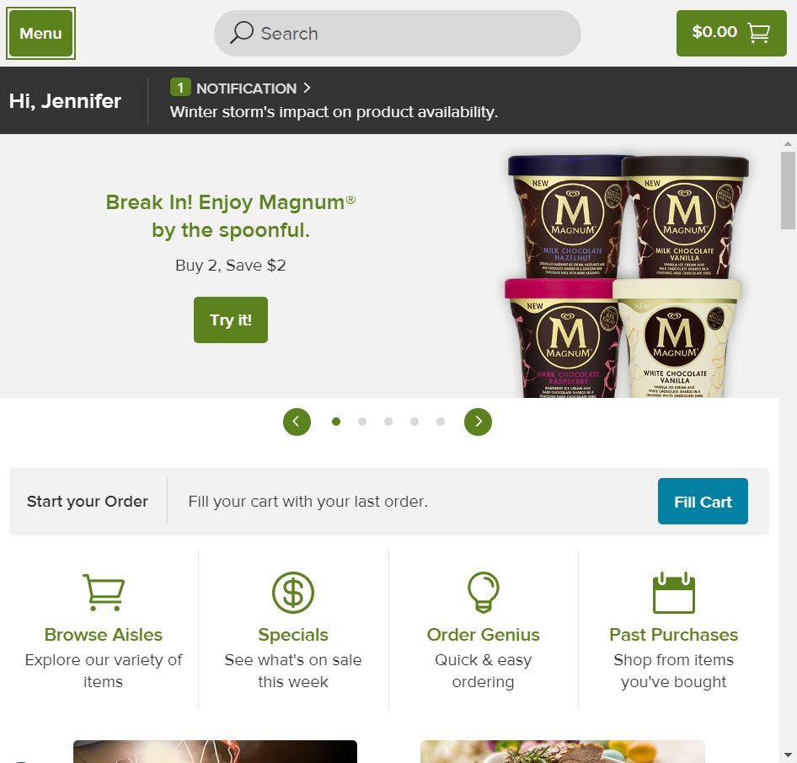
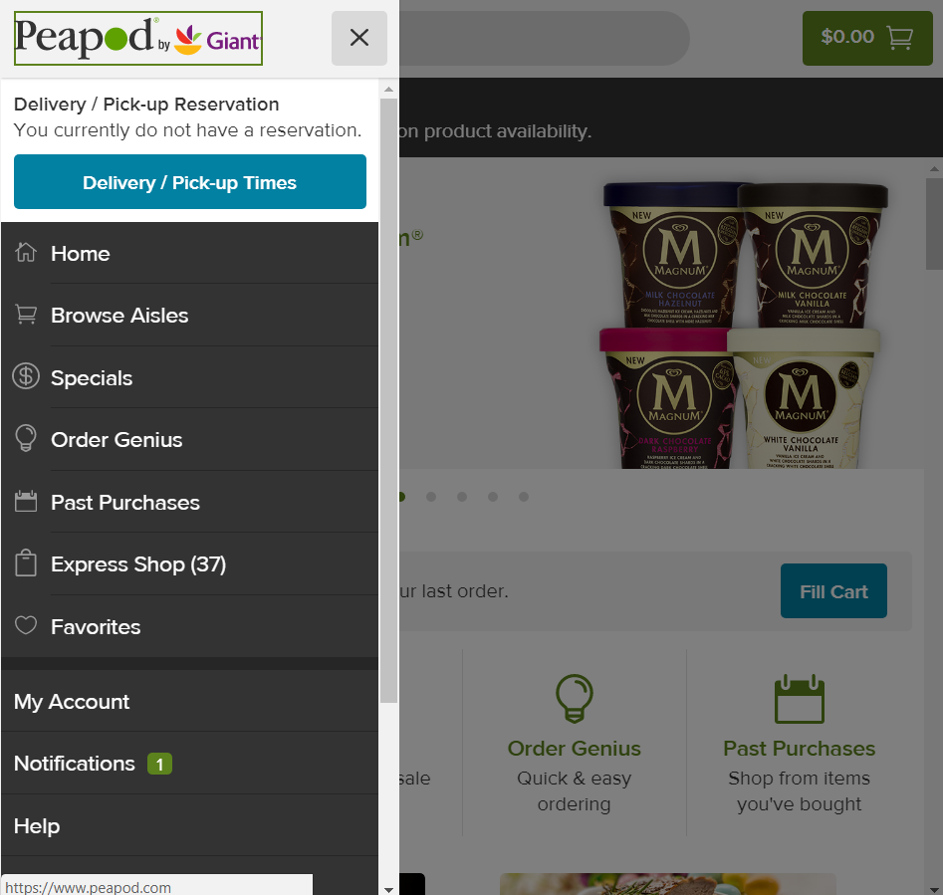
Scenario 1: Mobile “Menu”
Jen multi-tasks (during half-time) at her son’s soccer game. She logs on to Peapod.com to start her grocery order. She activates the “Menu” button, a panel slides out from the right and focus moves into the panel.
Notes:
Is this a A) Change of Content; B) Change of Content and Change of Context?
Answer: B
Change of Content and Change of Context (focus moves into dialog/panel and stays trapped there until the user makes a selection or closes the dialog). Then focus moves back to the triggering element.

Slide 15
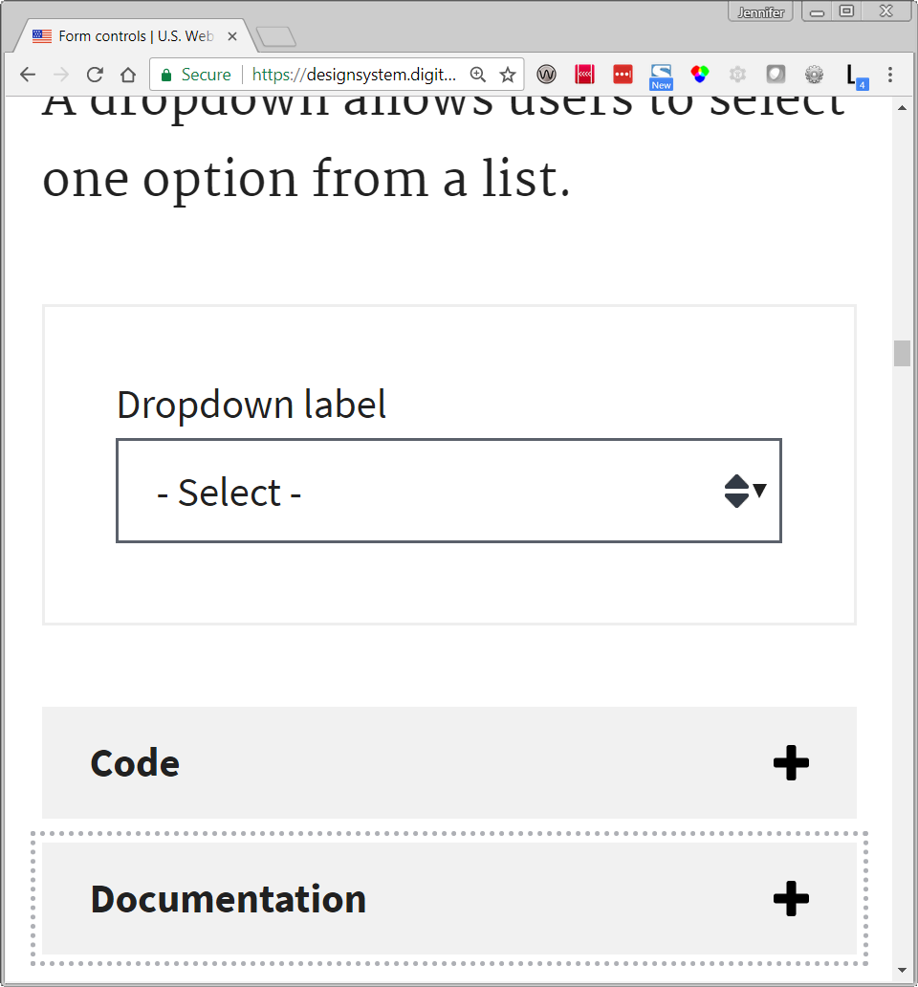
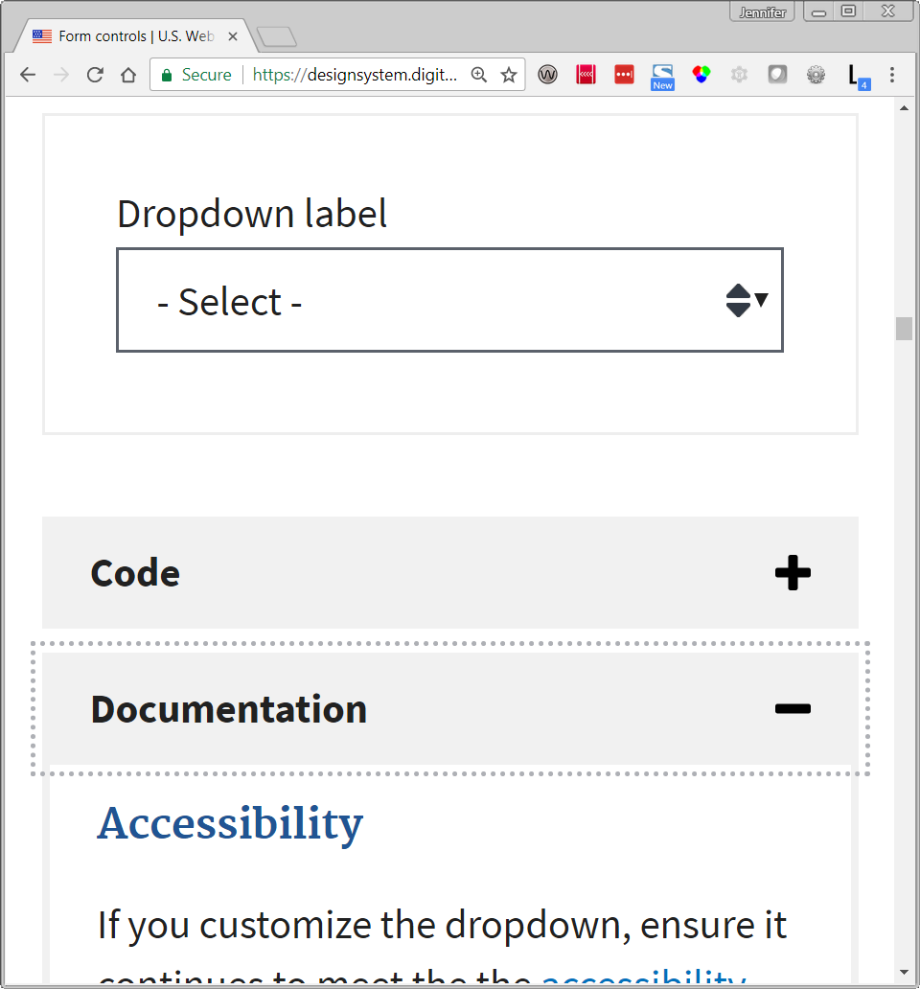
Scenario 2: Show/Hide Sections
Betty, a designer, wants to create a custom drop-down list for a Federal client. She visits the U.S. Web Design System site and finds the section of the Form Controls page on dropdowns. She tabs to and activates the Documentation button. A panel with accessibility guidance is shown and focus remains on the button.
Notes:
Screen Capture Source: https://designsystem.digital.gov/components/form-controls/
Is this a A) Change of Content; B) Change of Content and Change of Context?
Answer: Change of Content, content panel dynamically expanded but focus remains on the header button as the expand/collapse trigger

Slide 16
Lessons Learned
Drop-Down Lists, Content Changes and Focus

Slide 17
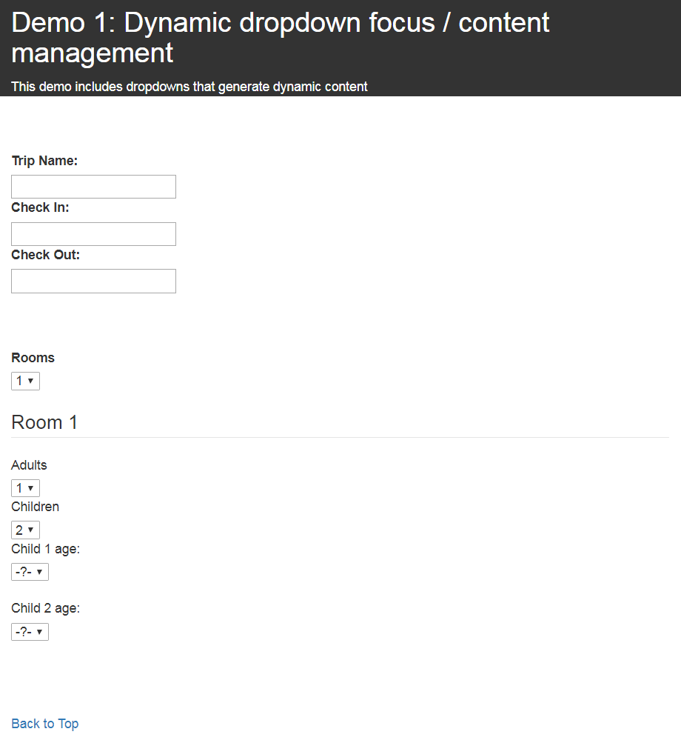
Pattern: Dependent HTML 5 <select> Elements
Selecting a value from a drop-down list can serve as the trigger for a “downstream” change of content
User sets focus to first drop-down list
Reviews the list of options
Select one option as the value
Page content updates to show additional sections based on the number of rooms needed
User tabs to move focus to next logical drop-down list (Adults)
REPEAT pattern for additional dependent fields (e.g., Children & Child X age)
Notes:
when Alt + Down Arrow is used to expand a drop-down and make a selection AND the selection triggers dynamic fields to appear “downstream”

Slide 18
Methods for Operating Drop-Down Lists
There are multiple ways a keyboard user can select a value from a drop-down list
Use arrow keys to select option
Expand drop-down (Alt + Down Arrow), use arrow keys to select option and then press Tab (which sets the value and moves focus to next control)
Expand drop-down, use arrow keys to select option and then press Enter to set the value
Expand drop-down, use arrow keys to select option and then collapse the drop-down (Alt + Up Arrow) and set the value
However, when the user pressed Tab to move on to the next field their Focus Order was NOT logical
User’s choice of browser affects their success
User’s method to operate the drop-down affects their experience

Slide 19
Drop-Down Lists Demonstration
One Issue, Two Possible Solutions
Notes:
Demo:
IE 11
Chrome
“Typical” navigation: Tab to control, arrow to select an option (drop-down remains in a collapsed state), and Tab to next control
i. Expand drop-down: Tab to control, Alt+Down Arrow to expand drop-down, user arrows to select an option, and press Enter to update value and then press Tab to move to the next control [Won’t work as expected if a form has a default “submit” button that fires whenever a user presses Enter in the form]
ii. Freedom Scientific’s proposed operation: Tab to control, Alt+Down Arrow to expand drop-down, user arrows to select an option, and press Alt+Up Arrow to collapse drop-down and update value, and then press Tab to move to the next control
Client’s navigation: Tab to control, Alt+Down Arrow to expand drop-down, user arrows to select an option, and Tab to update value with selected option AND then move focus to the next control
The next slide includes a comparison of results for IE11, Edge, Firefox and Chrome.

Slide 20
Summary: Operation Methods/Browser Behavior
Operation Methods | IE 11 and Edge | Chrome and Firefox
Use arrow keys to make selection and press Tab (control remains collapsed) | Focus set to next logical control | Focus set to next logical control
Expand drop-down, use arrows to select option and press Enter to make a selection then press Tab | Enter collapses control, Tab moves focus to the next logical control | Enter collapses control, Tab moves focus to the next logical control
Expand drop-down, use arrows to select option and use alt + up arrow to collapse the drop-down and update value then press Tab | Control collapses, Tab moves focus to the next logical control | Control collapses, Tab moves focus to the next logical control
Expand drop-down, use arrows to select option then press Tab (Client/Tester’s Preference) | Focus set to control that was “next” in the tab order. ISSUE: Newly added content missed! | Tab collapses control, focus stays on control

Slide 21
Lessons Learned for Future Design Reviews
Simply saying it’s okay to trigger a change of content “downstream” is an oversimplification
Need to consider how and WHEN the focus order will be impacted by the content change
Predictable, logical focus order is easiest with drop-down lists that trigger a change in content IF there is a persistent control immediately following the drop-down list
If not, define requirements for
The custom scripting solution for IE 11 and Edge
Alternate controls that can capture the same input with less variability

Slide 22
Designing for User Interactions

Slide 23
Designing an Effective User Interface is like Having a Good Conversation
Every user interface (UI) is a means of communication
Users come to a web site, web application, or mobile app with a goal in mind
The UI either supports or prevents them from achieving that goal
An effective UI:
provides the expected information in plain language
accepts user inputs
responds with meaningful messaging and outputs
Design Flaw | User Experience (UX) Impact
Present too much information | User can’t easily get what they need, feels overwhelmed
Provide too little information (e.g., poor labeling or instructions) | User doesn’t understand what’s expected, makes errors, feels frustrated
Interrupt or make users repeat themselves | User is distracted, possibly annoyed and unable to efficiently complete task
Notes:
From a general usability perspective, talk about the dialogue between user and system…

Slide 24
How to Document “UI Conversations”
When conducting accessibility design review sessions with a design and/or development team, ask:
Does any content dynamically appear in the UI?
If yes, identify triggers for the potential states/transformations
Annotate mockups for the various interaction paths and states of the page so that the expected input/output is defined for each scenario
Is “focus management” needed to change the user’s context in response to a user’s action?
User interactions that trigger a change in content should include:
User Input
Triggering element
Content change (per input/option/value)
Hide/Show Content
Add/Remove Content
User interactions that trigger a change in context should include:
User action
Triggering element
Content change (add/modify content)
Context changes from/to

Slide 25
Predictable Input / Output Patterns
A system shows it’s “listening” by responding to user input.
How? Usually either a change of content alone or a combination of change of content & context
Content changes
Revealing/Hiding related content
Visual design/Programmatic state change to a UI component
Messaging
Context changes
“Focus Management” to move focus to:
a different component
a new page or location on the same page
a new “view” in a single page application (SPA)
Opening a new browser tab
Opening a new platform window
Re-arranging a significant amount of the page’s content
Notes:
Define User Input / System Output Design Patterns
User Input = User starts the “conversation”
System Output = Can be done through messaging, content changes and/or context changes
Depends upon the UI element they interacted with
How do users give their permission? Explicit input such as...
Activating a link - I want to go somewhere, take me there
Activating a button - I was to perform an action, do it now
Just as we are taught in communication skills/effective listener training to reiterate or restate what you heard to confirm understanding (seek first to understand then to be understood), the UI should respond to the user's input

Slide 26
“Focus Management” for User-Initiated Actions
For one client, based on user feedback, we’ve developed some common design patterns for “focus management” to change the user’s context in response to certain user-initiated actions that cause a change in content.
Workflows
When the user activates the Next or Continue button, within a series of web pages used to accomplish a task, the user’s focus is dynamically set to the start of the main content area on all secondary pages to avoid the user having to listen to repetitive blocks of content at the start of each page
Search Results
If a search form dynamically updates a page to show a set of results at the bottom of the page then when the user activates the Search button focus is moved to the start of the results region
Notes:
What is focus management?
Define “focus” (first more broadly outside the context of UI design then in the more traditional sense of UI interaction)
When content is dynamically added or modified within a page (changes in content) the dynamic update(s) can be difficult for users with different abilities to perceive, especially blind screen reader users.
Who needs it and when? Everyone...but their experience may be different depending upon the method they use to provide their input to your UI...
Input via sequential access pattern: keyboard input (tab order)
Input via random access pattern: keyboard input (access keys/shortcuts), mouse input, touch input, voice input
WORKFLOWS – Benefits for different users’ input methods…
Keyboard Input: Users do not have to tab through repetitive navigation links in the header or navigation regions of the page
Low Vision: Users do not have to scan and scroll/navigate past repetitive blocks of content to find the main content of the page
Blind: Users do not have to listen to a screen reader announce repetitive blocks of content at the start of the page and then ask to navigate to the start of the main content

Slide 27
“Focus Management” for Data Entry
For one client, based on user feedback, we’ve developed some common design patterns for “focus management” to change the user’s context in response to certain data entry actions that cause a change in content.
Adding New Records
If a user activates an Add button to create a new record to add to an existing table, a dialog opens and focus moves to the dialog so the user can provide the mandatory input. When the user finishes their data entry, the dialog closes and focus returns to a confirmation message on the primary page.
Error Handling
Upon form submission, if errors are detected focus is set to the start of a common error handling region at the top of the main content area to notify the user one or more problems were encountered and the details of each error.
Notes:
What is focus management?
Define “focus” (first more broadly outside the context of UI design then in the more traditional sense of UI interaction)
When content is dynamically added or modified within a page (changes in content) the dynamic update(s) can be difficult for users with different abilities to perceive, especially blind screen reader users.
Who needs it and when? Everyone...but their experience may be different depending upon the method they use to provide their input to your UI...
Input via sequential access pattern: keyboard input (tab order)
Input via random access pattern: keyboard input (access keys/shortcuts), mouse input, touch input, voice input
WORKFLOWS – Benefits for different users’ input methods…
Keyboard Input: Users do not have to tab through repetitive navigation links in the header or navigation regions of the page
Low Vision: Users do not have to scan and scroll/navigate past repetitive blocks of content to find the main content of the page
Blind: Users do not have to listen to a screen reader announce repetitive blocks of content at the start of the page and then ask to navigate to the start of the main content

Slide 28
ARIA 1.1 Design Patterns to Support Notification of Content Changes WITHOUT Moving Focus
ARIA role | How Does It Work? | Practical Use
tooltip | New content is programmatically exposed to Assistive Technologies as part of the UI control’s accessible description through the use of aria-describedby | Useful for contextual help, formatting guidance for input controls
status | Fires an implicit “polite” live region to notify screen reader users of the changed content | Useful for conveying status changes that are not urgent
alert | Fires an implicit “assertive” live region to notify screen reader users of the changed content | Useful for urgent notifications that don’t require user interaction

Slide 29
Looking to the Future
WCAG 2.1 SC 3.2.6 Status Changes

Slide 30
Understanding Draft SC 3.2.6 Status Changes
Success Criterion (SC) 3.2.6 Status Changes is proposed at the AA level WCAG 2.1
Intended to address scenarios where new content is added without changing the user’s context.
Goal is to ensure more users can be made aware of important changes in content that are not given focus, in a way that does not unnecessarily interrupt their work.
Source: W3C WCAG 2.1 Candidate Recommendation 30 Jan. 2018, https://www.w3.org/TR/WCAG21/#status-changes
Example User Action Taken | Expected Screen Reader Announcement
Search button activated | X results returned
Items added to shopping cart | Shopping cart, X items
Successful submission of a form | Your form was successfully submitted
Processing icon appears on the page and then disappears | Application busy then Application available

Slide 31
Stick Around...
The next session in this room “When Focus Matters: Managing Focus within Data Tables” will be presented by two of our colleagues Elizabeth Whitmer and Pavani Gonuguntla.
In Part 2 of “When Focus Matters” you can learn more about managing focus and communicating status changes for various data table interactions, including:
sorting,
pagination,
live filtering
adding/removing data.

Slide 32
Administrative Wrap-Up
Slides: You can access our demos and view or download a copy of the PowerPoint slides from: https://tinyurl.com/csunatc18-cgi
Questions after the session? Contact us at:
Jennifer Gauvreau, @jlgauvreau jennifer.gauvreau@cgifederal.com
Karen Herndon, @kwherndon karen.herndon@cgifederal.com
Development Credit: Special thanks to CGI developer Sot Kiep for developing all the working demos for this session!

Slide 33
Questions?

Slide 34
References

Slide 35
Useful References
WCAG 2.0 Quick Reference: https://www.w3.org/WAI/WCAG20/quickref/
Accessible Rich Internet Applications (WAI-ARIA) 1.1, W3C Candidate Recommendation 27 October 2016: https://www.w3.org/TR/wai-aria-1.1/
WAI-ARIA 1.1 Authoring Practices Guide (APG), W3C Working Draft 28 June 2017: https://www.w3.org/TR/wai-aria-practices-1.1/

